Slide 1

POWER MANAGEMENT IN IOS
ABDALLAH MAHMOUD
MOUHAB MAHMOUD
OMAR OSAMA

Slide 2
AGENDA
Energy Efficiency and the User Experience
IOS ENERGY SAVING TECHNOLOGIES
POWER CONSUMERS
Fixed VS. DYNAMIC POWER COST
GUIDELINES FOR POWER MANAGEMENT
TIPS FOR DEVELOPERS

Slide 3
ENERGY EFFICIENCY AND THE USER EXPERIENCE
All apps consume energy—whenever they perform networking operations, update the user interface, or run code on the CPU. As users rely increasingly on battery power—and as apps proliferate—energy efficiency becomes integral to the user experience.

Slide 4
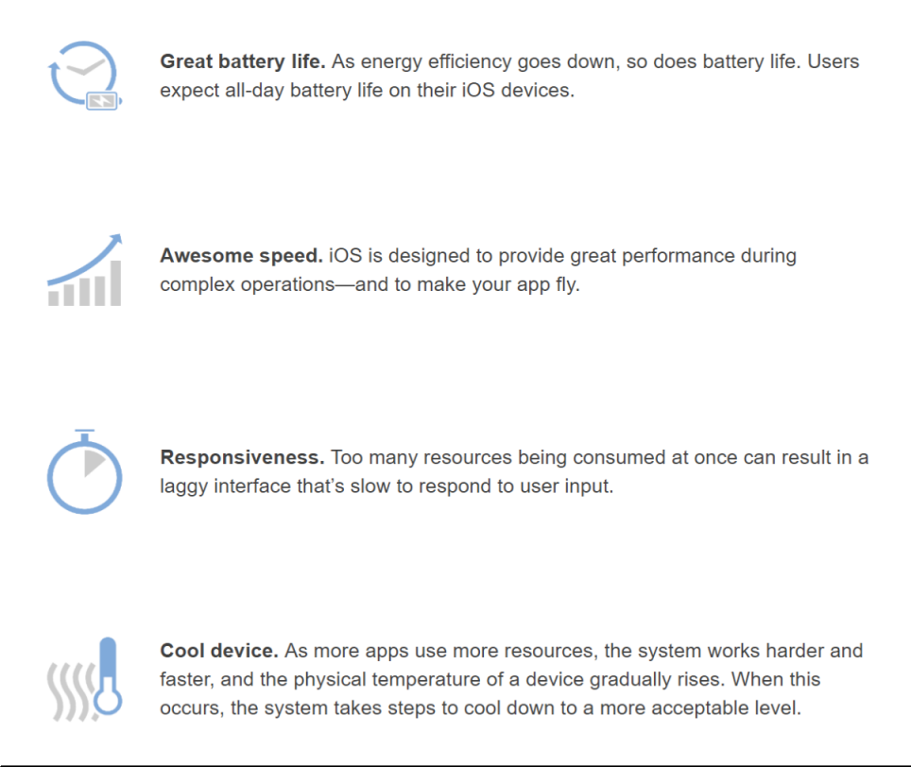
A GREAT USER EXPERIENCE REQUIRES

Slide 5
iOS Energy-Saving Technologies
iOS employs advanced energy-saving technologies that help users get the most out of their devices. These features help the system make smart decisions about how to use resources and run code as efficiently as possible.

Slide 6
Integrated Hardware and Software
iOS integrates with advanced hardware features such as a power efficient CPU, accelerated graphics, and wireless antennas. Hardware and software work together to deliver an optimized user experience that’s great for battery life.

Slide 7
Intelligent App Management
iOS apps have a life cycle that’s managed by the system. When a user finishes interacting with an app, the app is placed into a background state, where activity is throttled and the app may be suspended. Apps generating high CPU usage for extended periods of time while running in the background may be terminated by the system, if necessary.

Slide 8
Network Operation Deferral
APIs let you designate criteria that indicate when and how often a network operation should be deferred, how long it can be deferred, and under what circumstances. The system uses this information to defer the operation until an energy efficient time.

Slide 9
Task Prioritization
Tasks that affect the user, such as downloading and playing music, take priority over background and discretionary workالعمل التقديرى. Quality of service class APIs allow you to assign priority levels to the work your app performs, giving you fine-grained control over task prioritization.

Slide 10
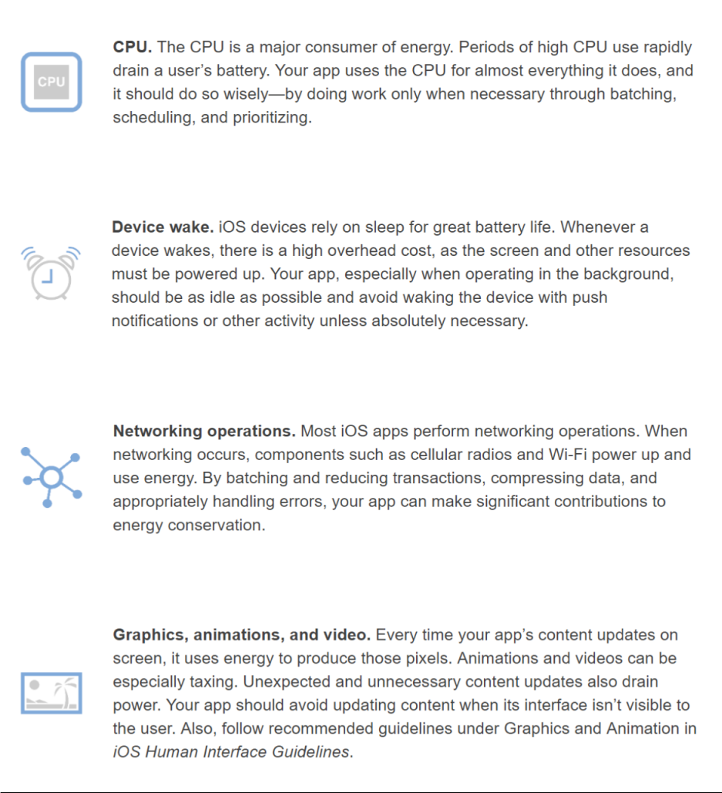
POWER CONSUMERS
There’s no single solution for conserving energy on a device. Numerous technologies and operations influence how energy is used:

Slide 11
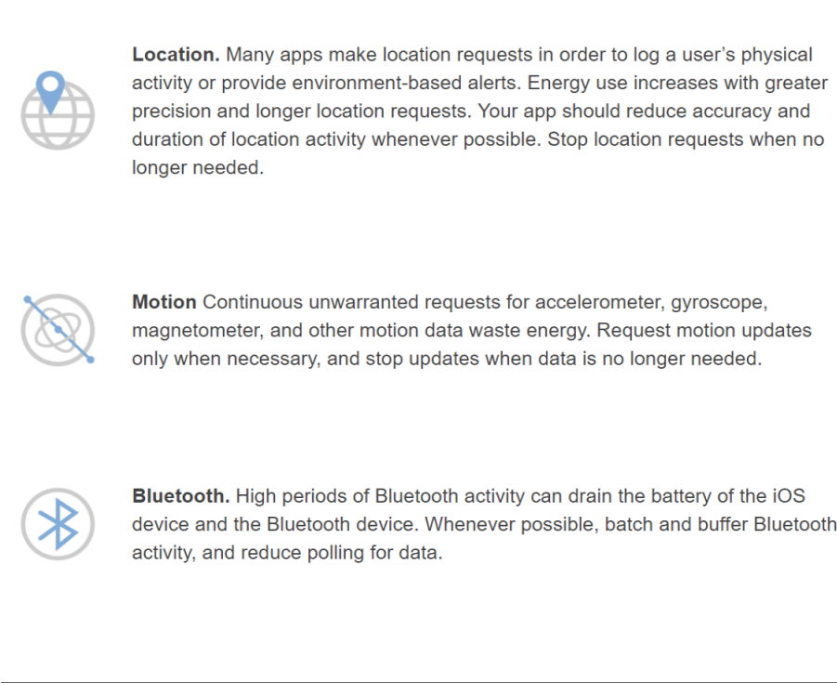
POWER CONSUMERS
There’s no single solution for conserving energy on a device. Numerous technologies and operations influence how energy is used:

Slide 12
Fixed Cost and Dynamic Cost
Tasks your app performs have a dynamic cost—how much energy your app uses by doing actual work. They also have a fixed cost—how much energy is used by bringing the system and various resources up in order for your app to do work, and back down after that work is complete. When lots of sporadic متقطع work is occurring, there are dynamic costs and a significant fixed cost too, as resources may never get the chance to reach true idle between the sporadic tasks. This situation results in a lot of energy being used for a relatively small amount of actual work.

Slide 13
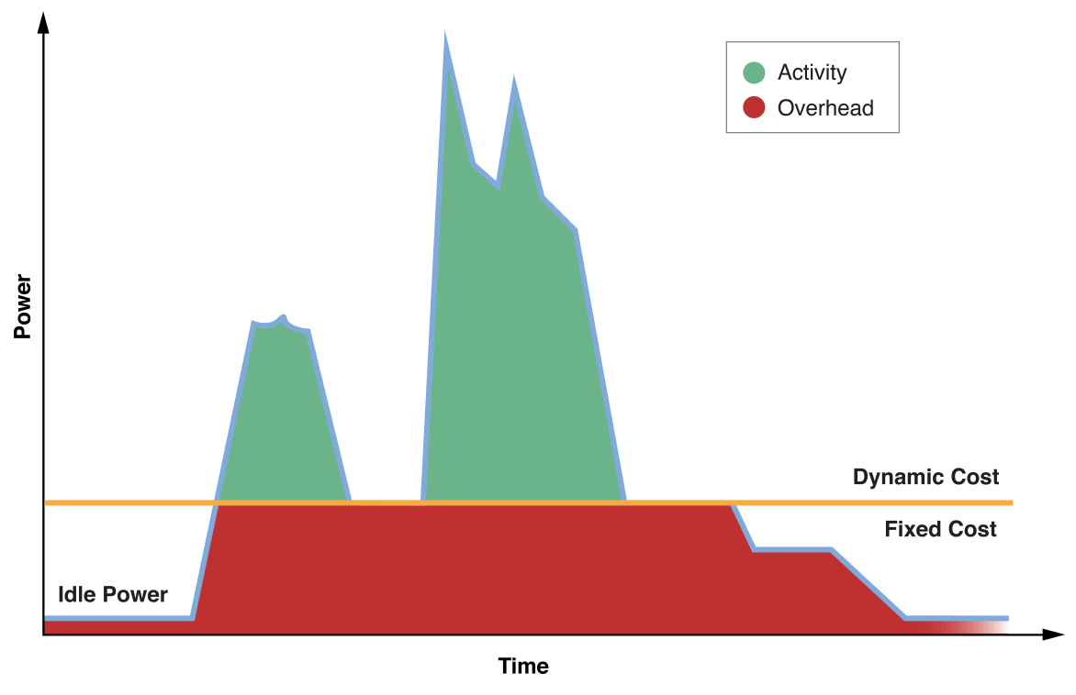

Slide 14
GUIDELINES FOR POWER MANAGEMENT
Work Less in the Background
Minimize I/O
React to Low Power Mode on iPhones
Minimize and Defer Networking
Use Graphics, Animations, and Video Efficiently
Reduce Location Accuracy and Duration

Slide 15
Work Less in the Background
When the user isn’t actively using your app, the system places it into a background state. The system may eventually suspend your app if it’s not performing important work, such as finishing a task the user initiated or running in a specially declared background execution mode
Your app shouldn’t wait to be suspended by the system. It should begin winding down انهاءactivity immediately once notified that state has changed. When your app completes any remaining tasks, it should notify the system that background activity is complete. Failing to do so causes the app to remain active and draw energy unnecessarily.

Slide 16
Minimize I/O
Every time your app performs I/O-related tasks, such as writing file data, it brings the system out of an idle state. By writing data less, aggregating writes together, using caching wisely, scheduling network transactions, and minimizing overall I/O, you can boost the energy efficiency and performance of your app.

Slide 17
Minimize and Defer Networking
Almost all iOS apps perform network operations of some kind, and it’s essential that networking be employed efficiently. This means eliminating overhead cost whenever possible by reducing and scheduling transactions, and using efficient APIs.
Network operations may be unavoidable and essential to your app. In many cases, however, networking can be minimized by adhering to some general guidelines.
Apps that perform network operations should batch transactions and use appropriate APIs to minimize radio use, limit impact on the system, and increase energy efficiency. Apps should also let the system defer nonessential network activity for optimal times, such as when the device is plugged in or using Wi-Fi.

Slide 18
Use Graphics, Animations, and Video Efficiently
Every time your app updates (or “draws”) content to screen, it requires the CPU, GPU, and screen to be active. Extraneous or inefficient drawing can pull system resources out of low-power states or prevent them from powering down altogether, resulting in significant energy use.
Follow these guidelines to optimize content refreshes:
Reduce the number of views your app uses.
Reduce the use of opacity
Use recommended frameworks when developing games. These frameworks are optimized to provide great performance and optimal energy efficiency
Use a consistent frame rate when performing an animation. For example, if your app displays 60 frames per second, maintain that frame rate throughout the lifetime of the animation.

Slide 19
Reduce Location Accuracy and Duration
Using location-based information in your app is a great way to keep the user connected to the surrounding world. However, improper or unnecessary use of location can prevent the device from sleeping, keep location hardware powered up, drain the user’s battery, and create a poor user experience. Follow best practices to optimize use of location services for energy efficiency.

Slide 20
TIPS FOR DEVELOPERS
Use recommended APIs so the system can make smart decisions about how best to manage your app and the resources it uses.
Whenever possible, batch and reduce network operations, and avoid unnecessary updates to the user interface.
Power-intensive operations should be under the user’s control. If a user is playing a graphics-heavy game, for example, the user should not be surprised if the activity consumes power.
Strive to make your app absolutely idle when it is not responding to user input.

